Slide 1
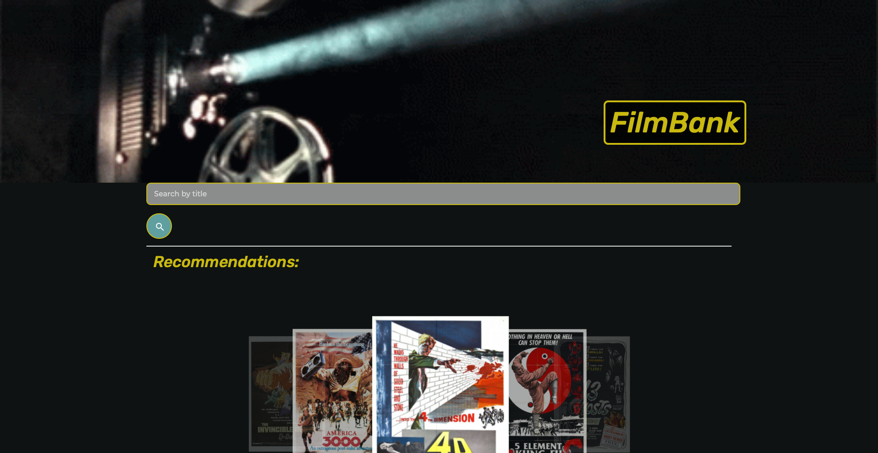
Joey Castillo
Lisa Goodell
Yihsien Lu
Scott Willrich

Slide 2
Agenda
Elevator Pitch
Concept
Process
Demo
Future Development / Enhancements
Links
Questions

Slide 3
Elevator Pitch
FilmBank gives a user the ability to:
Search for a film from any time in any genre
See a list of films that meet the search criteria
Get a description of any film including:
Description
Release Date
Cast
Where It’s Streaming
New York Times Movie Review

Slide 4
Concept
FilmBank gives a user the ability to:
Search for a film from any time in any genre
See a list of films that meet the search criteria
Get a description of any film including:
Description
Release Date
Cast
Where It’s Streaming
New York Times Movie Review

Slide 5
Technology
HTML
Materialize CSS
JavaScript
The Movie Database (TMDB) API
The New York Times Movie Review API

Slide 6
Collaboration & Division of Work
Difficult on Small Project
Collaboration on Concept / CSS Framework Selection
Roles (shared as much as possible)
HTML Development
JavaScript Development
Incorporation of Materialize
Slide / README Development
Project Management

Slide 7
Challenges We Overcame
Small Project - Division of Work
Finding an API that provided the information we needed
GitHub - Branching and Merging
Learning a New CSS Framework

Slide 8
Filmbank Demo

Slide 9
Enhancements / Future Development
Incorporating Additional Data
TV Shows
Links to Streaming Providers
Film Trailers
Actor Bios
What’s in Theaters
Mark a Movie as a Favorite

Slide 10
Links
Deployed Application
https://swillrich5.github.io/filmbank/
GitHub Repository
https://github.com/swillrich5/filmbank/
Developers
Joey Castillo | joeycastilloo558@gmail.com
Lisa Goodell | robotsinboxes@gmail.com
Yihsien Lu | alecfirstapple@gmail.com
Scott Willrich | swillrich@gmail.com

Slide 11

Thank You / Questions

